Slide 1

Reactions of Copper

Slide 2
Copy of Lab
Cu(s) + 4 HNO₃(aq) -----> Cu(NO₃)₂(aq) + 2 NO₂(g) + 2 H₂O(l) Redox [1]
Cu(NO₃)₂(aq) + 2 NaOH(aq) -----> Cu(OH)₂(s) + 2 NaNO₃(aq) Double Replacement [2]
Cu(OH)₂(s) -----> CuO(s) + H₂O(g) Dehydration [3]
CuO(s) + H₂SO₄(aq) -----> CuSO₄(aq) + H₂O(l) Double Replacement [4]
CuSO₄(aq) + Zn(s) -----> ZnSO₄(aq) + Cu(s) Single Replacement [5]

Slide 3
Copy of Procedure

Slide 4

Procedure: Day One
Weigh approximately 0.5 g (+/- 0.05) of copper wire to the nearest 0.001 g and place it in a 250 mL beaker. In your data table, record the exact mass of Cu you used
Fume Hood 1
Reaction A: Add 4 - 5 mL of concentrated nitric acid (HNO₃) to your beaker with the Cu. For safety reasons, instead of measuring this volume using a graduated cylinder, you will use two full squirts of nitric acid from a disposable pipet. Carefully swirl the beaker and make observations while the reaction is occurring. Once the reaction is complete, it should no longer produce brown gas. You may now leave the fume hood.
Before you proceed with the next step, write down your observations from Reaction A on your report sheet. Include as much detail as possible (e.g., color changes, production of gas, heat changes).
In reaction A, you reacted copper metal with nitric acid to produce aqueous copper (II) nitrate, nitrogen dioxide gas, and liquid water. On your report sheet, write and balance this equation, showing the correct phases of each chemical.
Add 100 mL distilled H₂O to your beaker. Write down your observations on your report sheet.
Cu(s) + 4 HNO₃(aq) -----> Cu(NO₃)₂(aq) + 2 NO₂(g) + 2 H₂O(l)

Slide 5
Fume Hood 2
Reaction B: Add 30 mL of 3.0 M sodium hydroxide (NaOH) to the solution in your beaker. You may leave the fume hood as the reaction proceeds.
Write down your observations on your report sheet.
In reaction B, you are reacting the copper (II) nitrate produced in reaction A with aqueous sodium hydroxide in a double replacement (DR) reaction.
On your report sheet, predict the products of this DR reaction and balance the equation, showing the correct phases of each chemical.

Slide 6
Reaction C: Carefully heat the solution on a hot plate and stir the solution constantly with a glass stirring rod. Heat the solution and stir until the blue gel has turned into a fine, black solid.
Write down your observations on your report sheet.
In reaction C, you are decomposing the copper (II) hydroxide produced in Reaction B by heating it on the hot plate.
Hint: This reaction could also be considered a dehydration reaction.
On your report sheet, predict the products of this reaction and balance the equation.

Slide 7
Allow the black solid precipitate, copper (II) oxide, to settle to the bottom of the beaker.
Decant off the liquid, leaving the solid behind.
Add about 50 mL distilled water to the beaker to rinse the solid.
Once the solid settles to the bottom, again decant off the liquid.
Rinse and decant two more times.

Slide 8
Procedure: Day Two
Fume Hood 1
Reaction D: In the fume hood, add 15 mL of 6.0 M sulfuric acid (H₂SO₄).
You may leave the fume hood as the reaction proceeds.
Write down your observations on your report sheet.
In reaction D, you are reacting the copper (II) oxide produced in reaction C
with sulfuric acid in a double replacement (DR) reaction.
On your report sheet, predict the products of this DR reaction and balance the equation,
showing the correct phases of each chemical.

Slide 9
Fume Hood 2
Reaction E: Add several 2 cm squares of aluminum foil and a 3-5 drops of
concentrated hydrochloric acid (HCl) to your beaker.
Stir the solution and allow it to react.
Continue to add pieces of aluminum until the liquid becomes colorless.
Once the reaction has ceased, you may leave the fume hood. This will take overnight.
Write down your observations on your report sheet.
In reaction E, you are reacting the copper (II) sulfate produced in reaction D
with aluminum in a single replacement (SR) reaction.
On your report sheet, predict the products of this SR reaction and balance the equation.

Slide 10
Decant off the solution, leaving your copper solid behind.
Wash the copper with distilled water, and allow the copper to settle back down to the bottom.
Decant off the liquid, leaving the copper solid behind.
Mass a disposable plastic cup and record its mass on your report sheet.
Use a wash bottle to rinse and transfer the copper solid from the beaker into the cup.
Decant off the liquid, leaving the copper solid behind.
Allow the copper solid to dry overnight.
Mass the cup with the copper the following day.
Record this mass on your report sheet.

Slide 11
REPORT SHEET with Data
Chemical Reactions of Copper and Percent Yield
0.485 g
Day 1
1. Weight copper initial _______________
*2. Weight of recovered copper and evaporating dish _______________
3. Weight of evaporating dish _______________
*4. Weight of copper final _______________
*5. % Yield (show calculations) _______________
136.427 g
Day 3
135.973 g
Day 2
0.454 g
Day 3
Day 3
% yield = x 100
recovered weight of Cu
initial weight of Cu
*These values will not be obtained until the last day of the lab when the copper
has been dried in the evaporating dish.

Slide 12
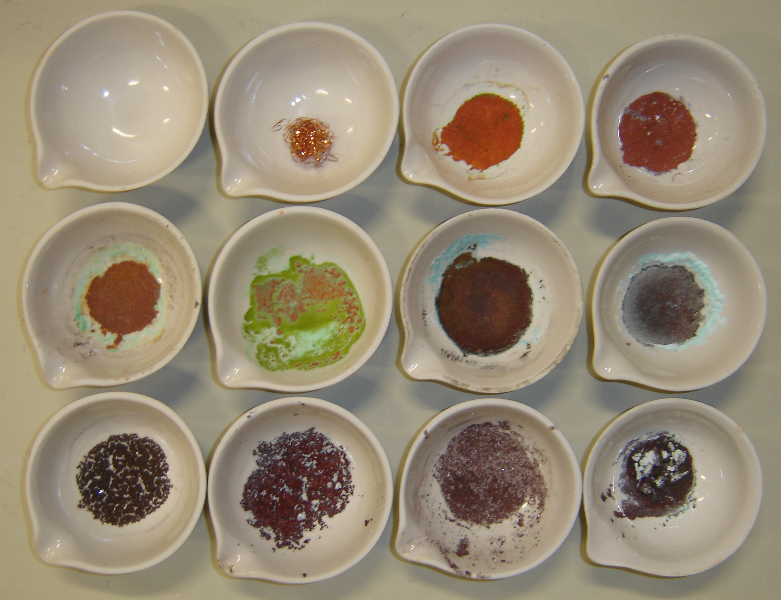
Cu sample at
beginning of lab
Few impurities…
should look like this!
Reactions
of Copper
CuCl₂
CuSO₄
Al foil
Al(SO₄)₃
AlCl₃
Photographs of copper samples at end of lab – note many have impurities.

Slide 13
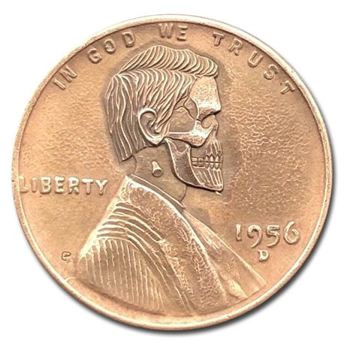
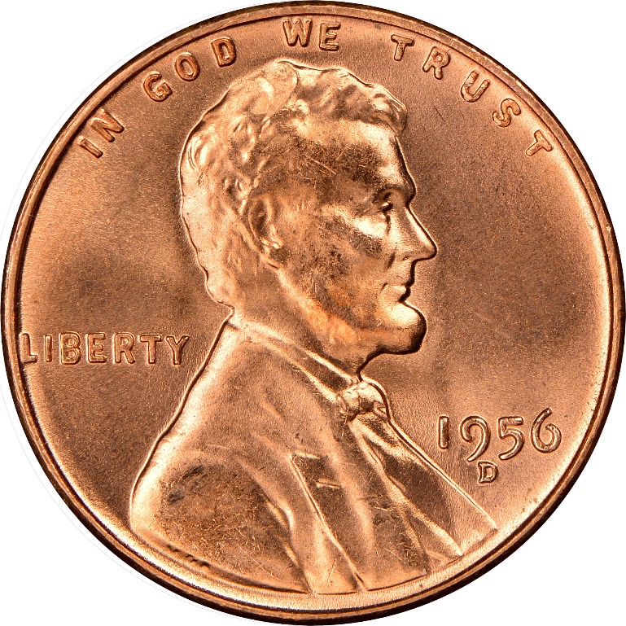
Mr. Lincoln has had a rough day, indeed.
Copper Metal S T A R T
Copper Metal E N D

Slide 14
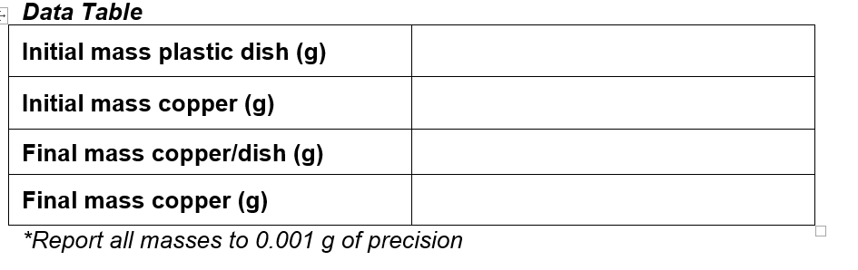

Slide 15
Pre-lab Questions
Define percent yield in general terms.
What is meant by the term decantation?
What is the difference between an endothermic and exothermic reaction? What observations allow you to tell the difference between the two?
After the experiment is complete, many students will have above 100% yield. How is this possible and what is the likely cause?

Slide 16
Lab Questions
1. Reaction A
Observations:
In reaction A, you reacted copper metal with nitric acid to produce aqueous copper (II) nitrate, nitrogen dioxide gas, and liquid water.
Write and balance this equation, showing the correct phases of each chemical.

Slide 17
2. Reaction B
Observations:
In reaction B, you are reacting
the copper (II) nitrate produced in reaction A with aqueous sodium hydroxide in a double replacement (DR) reaction.
Predict the products of this DR reaction and balance the equation, showing the correct phases of each chemical.

Slide 18
3. Reaction C
Observations:
In reaction C, you are decomposing the copper (II) hydroxide produced in Reaction B by heating it on the hot plate.
Hint: This reaction could also be considered a dehydration reaction.
Predict the products of this reaction and balance the equation.

Slide 19
4. Reaction D
Observations:
In reaction D, you are reacting the copper (II) oxide produced in reaction C with sulfuric acid in
a double replacement (DR) reaction.
On your report sheet, predict the products of this DR reaction and balance the equation,
showing the correct phases of each chemical.

Slide 20
5. Reaction E
Observations:
In reaction E, you are reacting the copper (II) sulfate produced in reaction D with aluminum in
a single replacement (SR) reaction.
On your report sheet, predict the products of this SR reaction and balance the equation.
6. In step 6 of the procedure from Day 1, you washed the solid with distilled water and decanted
it off several times. What purpose did that serve? Specifically, what chemical byproduct was washed away?

